Slide 1
Chapter 5
Digital Design and Computer Architecture, 2nd Edition
David Money Harris and Sarah L. Harris

Slide 2
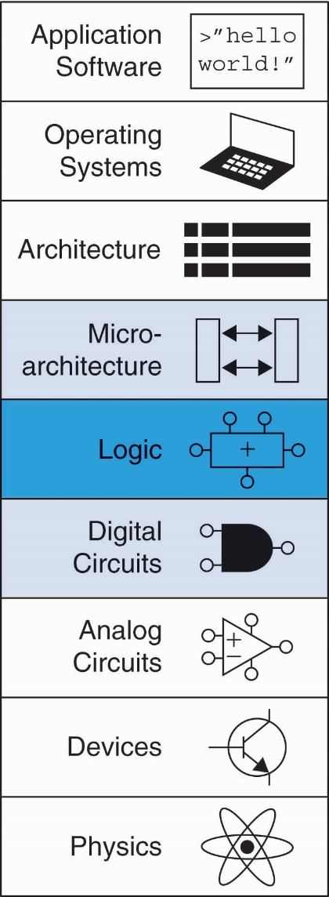
Chapter 5 :: Topics
Introduction
Arithmetic Circuits
Number Systems
Sequential Building Blocks
Memory Arrays
Logic Arrays

Slide 3
Introduction
Digital building blocks:
Gates, multiplexers, decoders, registers, arithmetic circuits, counters, memory arrays, logic arrays
Building blocks demonstrate hierarchy, modularity, and regularity:
Hierarchy of simpler components
Well-defined interfaces and functions
Regular structure easily extends to different sizes
Will use these building blocks in Chapter 7 to build microprocessor

Slide 4
1-Bit Adders

Slide 5
1-Bit Adders

Slide 6
1-Bit Adders

Slide 7
Multibit Adders (CPAs)
Types of carry propagate adders (CPAs):
Ripple-carry (slow)
Carry-lookahead (fast)
Prefix (faster)
Carry-lookahead and prefix adders faster for large adders but require more hardware
Symbol

Slide 8
Subtracter

Slide 9
Comparator: Equality

Slide 10
Comparator: Less Than

Slide 11
Arithmetic Logic Unit (ALU)
F_{2:0} | Function
000 | A & B
001 | A | B
010 | A + B
011 | not used
100 | A & ~B
101 | A | ~B
110 | A - B
111 | SLT

Slide 12
ALU Design
F_{2:0} | Function
000 | A & B
001 | A | B
010 | A + B
011 | not used
100 | A & ~B
101 | A | ~B
110 | A - B
111 | SLT

Slide 13
Set Less Than (SLT) Example
Configure 32-bit ALU for SLT operation: A = 25 and B = 32

Slide 14
Set Less Than (SLT) Example
Configure 32-bit ALU for SLT operation: A = 25 and B = 32
A < B, so Y should be 32-bit representation of 1 (0x00000001)
F_{2:0} = 111
F₂ = 1 (adder acts as subtracter), so 25 - 32 = -7
-7 has 1 in the most significant bit (S₃₁ = 1)
F_{1:0} = 11 multiplexer selects Y = S₃₁ (zero extended) = 0x00000001.

Slide 15
Shifters
Logical shifter: shifts value to left or right and fills empty spaces with 0’s
Ex: 11001 >> 2 =
Ex: 11001 << 2 =
Arithmetic shifter: same as logical shifter, but on right shift, fills empty spaces with the old most significant bit (msb).
Ex: 11001 >>> 2 =
Ex: 11001 <<< 2 =
Rotator: rotates bits in a circle, such that bits shifted off one end are shifted into the other end
Ex: 11001 ROR 2 =
Ex: 11001 ROL 2 =

Slide 16
Shifters
Logical shifter:
Ex: 11001 >> 2 = 00110
Ex: 11001 << 2 = 00100
Arithmetic shifter:
Ex: 11001 >>> 2 = 11110
Ex: 11001 <<< 2 = 00100
Rotator:
Ex: 11001 ROR 2 = 01110
Ex: 11001 ROL 2 = 00111

Slide 17
Shifter Design

Slide 18
Shifters as Multipliers, Dividers
A << N = A × 2^{N}
Example: 00001 << 2 = 00100 (1 × 2² = 4)
Example: 11101 << 2 = 10100 (-3 × 2² = -12)
A >>> N = A ÷ 2^{N}
Example: 01000 >>> 2 = 00010 (8 ÷ 2² = 2)
Example: 10000 >>> 2 = 11100 (-16 ÷ 2² = -4)

Slide 19
Number Systems
Numbers we can represent using binary representations
Positive numbers
Unsigned binary
Negative numbers
Two’s complement
Sign/magnitude numbers
What about fractions?

Slide 20
Registers

Slide 21
Counters
Increments on each clock edge
Used to cycle through numbers. For example,
000, 001, 010, 011, 100, 101, 110, 111, 000, 001…
Example uses:
Digital clock displays
Program counter: keeps track of current instruction executing

Slide 22
Shift Registers
Shift a new bit in on each clock edge
Shift a bit out on each clock edge
Serial-to-parallel converter: converts serial input (S_{in}) to parallel output (Q_{0:N-1})
Symbol:
Implementation:

Slide 23
Shift Register with Parallel Load
When Load = 1, acts as a normal N-bit register
When Load = 0, acts as a shift register
Now can act as a serial-to-parallel converter (S_{in} to Q_{0:N-1}) or a parallel-to-serial converter (D_{0:N-1} to S_{out})

Slide 24
Memory Arrays
Efficiently store large amounts of data
3 common types:
Dynamic random access memory (DRAM)
Static random access memory (SRAM)
Read only memory (ROM)
M-bit data value read/ written at each unique N-bit address

Slide 25
Memory Arrays
2-dimensional array of bit cells
Each bit cell stores one bit
N address bits and M data bits:
2^{N} rows and M columns
Depth: number of rows (number of words)
Width: number of columns (size of word)
Array size: depth × width = 2^{N} × M

Slide 26
Memory Array Example
2² × 3-bit array
Number of words: 4
Word size: 3-bits
For example, the 3-bit word stored at address 10 is 100

Slide 27
Memory Arrays

Slide 28
Memory Array Bit Cells
Z

Slide 29
Memory Array Bit Cells
0
Z
1
Z

Slide 30
Memory Array
Wordline:
like an enable
single row in memory array read/written
corresponds to unique address
only one wordline HIGH at once

Slide 31
Types of Memory
Random access memory (RAM): volatile
Read only memory (ROM): nonvolatile

Slide 32
RAM: Random Access Memory
Volatile: loses its data when power off
Read and written quickly
Main memory in your computer is RAM (DRAM)
Historically called random access memory because any data word accessed as easily as any other (in contrast to sequential access memories such as a tape recorder)

Slide 33
ROM: Read Only Memory
Nonvolatile: retains data when power off
Read quickly, but writing is impossible or slow
Flash memory in cameras, thumb drives, and digital cameras are all ROMs
Historically called read only memory because ROMs were written at manufacturing time or by burning fuses. Once ROM was configured, it could not be written again. This is no longer the case for Flash memory and other types of ROMs.

Slide 34
Types of RAM
DRAM (Dynamic random access memory)
SRAM (Static random access memory)
Differ in how they store data:
DRAM uses a capacitor
SRAM uses cross-coupled inverters

Slide 35
DRAM
Data bits stored on capacitor
Dynamic because the value needs to be refreshed (rewritten) periodically and after read:
Charge leakage from the capacitor degrades the value
Reading destroys the stored value

Slide 36
DRAM

Slide 37
SRAM

Slide 38
Bistable Circuit
Fundamental building block of other state elements
Two outputs: Q, Q
No inputs

Slide 39
Memory Arrays Review
DRAM bit cell:
SRAM bit cell:

Slide 40
ROM: Dot Notation

Slide 41
Multi-ported Memories
Port: address/data pair
3-ported memory
2 read ports (A1/RD1, A2/RD2)
1 write port (A3/WD3, WE3 enables writing)
Register file: small multi-ported memory

Slide 42
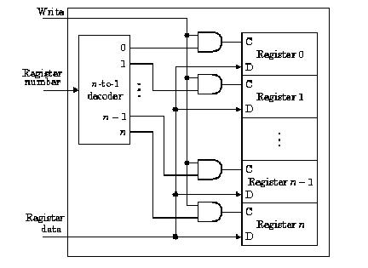
Write port

Slide 43
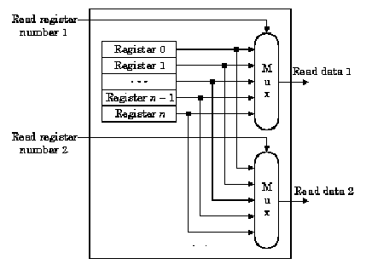
Read ports

Slide 44
Logic Arrays
PLAs (Programmable logic arrays)
AND array followed by OR array
Combinational logic only
Fixed internal connections
FPGAs (Field programmable gate arrays)
Array of Logic Elements (LEs)
Combinational and sequential logic
Programmable internal connections

